Slide 1
6th Annual
Doral Restaurant Week™
July 1 – July 31, 2017

Slide 2
Doral Restaurant Week™ What is it?
Doral Restaurant Week™ is a restaurant promotion that showcases the vast cultural cuisine that is available around Doral, Florida during the month of July.
As a city that is bursting at the seams with more than 200 restaurants, Doral Restaurant Week™ features special ‘prix fixe’ dining options at Doral’s finest restaurants.
Not only does Doral Restaurant Week™ boost business for your restaurants during the usually slow summer month of July, but it also encourages consumers to explore restaurants they have yet to discover.
www.atasteofdoral.com

Slide 3
Doral Restaurant Week™ How it Works
During Doral Restaurant Week™, participating restaurants will offer either special priced menu item(s), a percentage discount or a free Hors d’oeuvre, drink or dessert.
Diners can then to enjoy a Prix Fixe ‘Indulgence’ or ‘Lavish’ Dining experience at a Doral area fine restaurant.
www.atasteofdoral.com

Slide 4
Doral Restaurant Week™ All That’s Needed to Participate
1) Choose 1 to 3 items from their existing menu or create new items that cater to the Doral Restaurant Week (DRW) concept.
2) Send their menu or offer in text form to info@tasteofdoral.com
The new DRW menu should include:
A special menu item(s) offered with DRW special price
Or a percentage off price –minimum 25%
Or a free Hors d’oeuvre, dessert or free drink
3) Restaurants display DRW and Taste of Doral™ (ToD) marketing materials at entrance and throughout the restaurant: posters, flyers, stickers, etc. (We provide these!)
4) Social Media Marketing: Restauranteurs take photos, videos, interview diners who are taking advantage of the DRW deals, and post the materials to DRW’s social media sites using the hashtag #doralrestaurant !
5) They give us feedback: How many diners participated in DRW? Did they have lunch, or dinner? Any feedback will help the program – and your restaurant - grow!
www.atasteofdoral.com

Slide 5
Doral Restaurant Week™ Participants’ Benefits
Full month of marketing and promotions during July.
Listing, link, and description of restaurant on ToD website
DRW menu in ToD website
Taste of Doral Marketing Kit (folder with stickers/flyers, etc.)
Regularly posted specials and promotions on Taste of Doral™ Facebook Page and social media sites (40+ platforms)
Logo on our annual Doral Family Journal Taste of Doral™ Advertisement – be sure to send them in before June 30th!
Rotating daily featured restaurant in our ToD email – first come, first served!
www.atasteofdoral.com

Slide 6
Doral Restaurant Week™ Marketing and Promotional Visibility
Taste of Doral (ToD) Website
(www.atasteofdoral.com) with link to restaurant’s website
Doral Chamber of Commerce Web Site listing (www.doralchamber.com)
Daily ToD e-mail blast to 35,000 contacts
Press Releases announcing events and participating restaurants
Posting to 40+ Social Media Sites such as Facebook, Twitter, and Instagram
Print Ad Promotion
Television Promotion
Radio Promotion
Doral Family Journal – both printed and social Media Sponsor
Hashtag Promotion through #doralrestaurant
www.atasteofdoral.com

Slide 7
Doral Restaurant Week™ We’ll help generate Press Coverage like this…
This could be you!

Slide 8
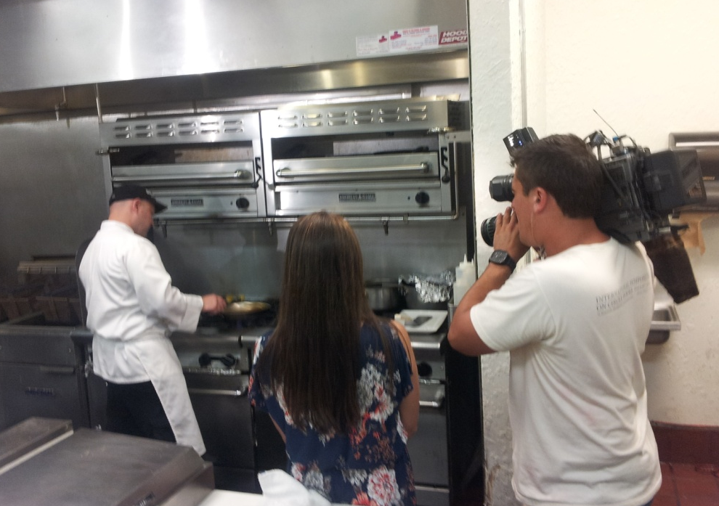
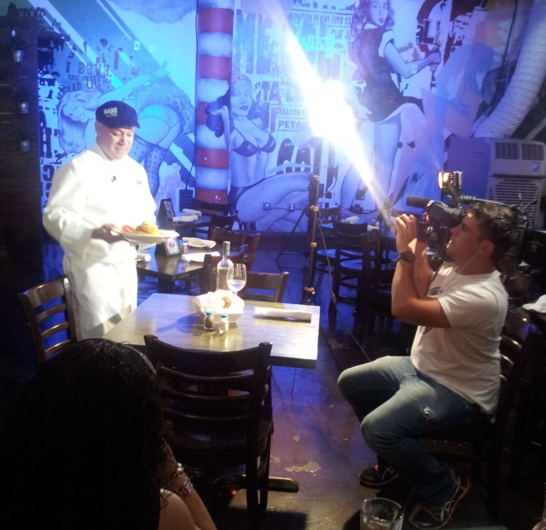
Doral Restaurant Week™ Press Coverage is HUGE!

Slide 9
Doral Restaurant Week Sponsor Benefits Be a Sponsor!
Platinum Title Sponsor
Company listed as “Title Sponsor” on all promotional materials
Individual press release announcing “Title Sponsorship”
Presenting Sponsorship on all paid, editorial media and promotional materials
Title Sponsor’s logo on all DRW email blasts (35,000+ contacts)
Investment - $5,000
Limit - 1
www.atasteofdoral.com

Slide 10
Doral Restaurant Week Sponsor Benefits
Golden Spoon Sponsor
Sponsor listing in press release
Sponsor logo on marketing and promotional materials
Sponsor logo on Doral Restaurant Week website and Doral Chamber of Commerce website
Social Media content inclusion and web connectivity to sponsor site
Title Sponsor’s logo on all DRW email blasts (35,000 contacts)
Presented at kick-off event
Investment- $2,500
Limit – 2
www.atasteofdoral.com

Slide 11
Doral Restaurant Week™ Sponsor Benefits
Silver Spoon Sponsorship
Sponsor logo on print advertisements
Sponsor logo on promotion materials
Sponsor logo on Doral Restaurant Week™ and Doral Chamber of Commerce website
Social Media content inclusion and web connectivity to sponsor site
Investment- $500
www.atasteofdoral.com

Slide 12
About the City of Doral
Over 150,000 employees come to work every day to the city.
Home to Fortune 500 companies and government headquarters
Best City in Florida for Business Start-ups by BusinessWeek
Named #2 of America's Top 25 towns to live well for its cultural amenities, pro-business environments, and highly educated workforce by Forbes.com
Total Population 50,213
Over 200 Restaurants in Doral
23 Hotels with a 85% occupancy rate
Remember, early sign-ups mean your restaurant or sponsorship gets advertised as early as possible! Don’t delay, and take advantage of this once-a-year opportunity to crack into one of the country’s most sumptuous markets!
To participate, please contact:
Azahy Arencibia at (305) 477-7600 or info@tasteofdoral.com
www.atasteofdoral.com

